Slide 1

Geometry
Unit 4, Lesson 6 Isometry Volume 1, pg. 206

Slide 2


Benchmarks
MA.912.GR.2.3 Specify a sequence of transformations that will map a given figure onto itself, or onto another congruent or similar figure.
MA.912.GR.2.6 Apply rigid transformations to map one figure onto another to justify that the two figures are congruent.
volume 1, pg. 206

Slide 3
Integrated Mathematical Thinking and Reasoning Standards
MA.K12.MTR.1.1 Actively participate in effortful learning both individually and collectively.
MA.K12.MTR.2.1 Demonstrate understanding by representing problems in multiple ways.
MA.K12.MTR.4.1 Engage in discussions that reflect on the mathematical thinking of self and others.
MA.K12.MTR.5.1 Use patterns and structure to help understand and connect mathematical concepts.
MA.K12.MTR.6.1 Assess the reasonableness of solutions.
volume 1, pg. 206

Slide 4

Learning Targets
I can describe a sequence of transformations that map one figure onto another congruent figure.
I can draw an image given a preimage and a sequence of transformations on a coordinate plane.
volume 1, pg. 206

Slide 5

Warm-Up
volume 1, pg. 207

Slide 6
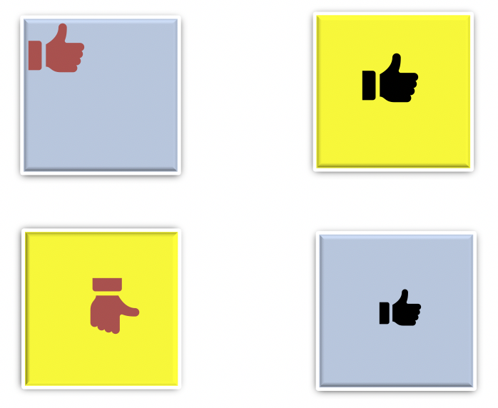
4.6.1 Warm-Up: Which One Doesn’t Belong?
Which one doesn’t belong? Explain your choice.
volume 1, pg. 207

Slide 7

Exploration
volume 1, pg. 207

Slide 8

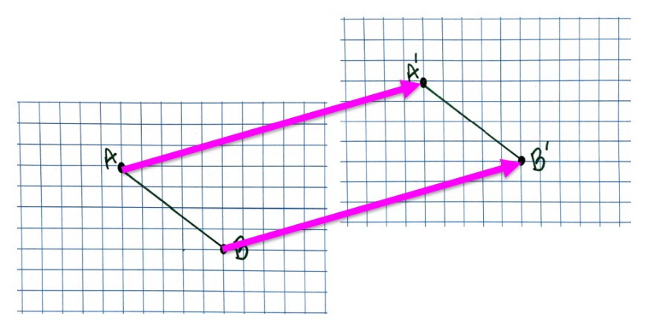
4.6.2 Exploration: Transforming Parts
Traci drew $\overline{AB}$ on a piece of graph paper. She then moved the graph paper up and over to the right, as shown by the arrows. The movement created $\overline{A′B′}$.
The graph paper is a real-life example of a plane. When an object is moved, flipped, or rotated, it is the plane that the object is on that moved. This means that every point on the plane is moved, flipped, or rotated.
volume 1, pg. 207

Slide 9
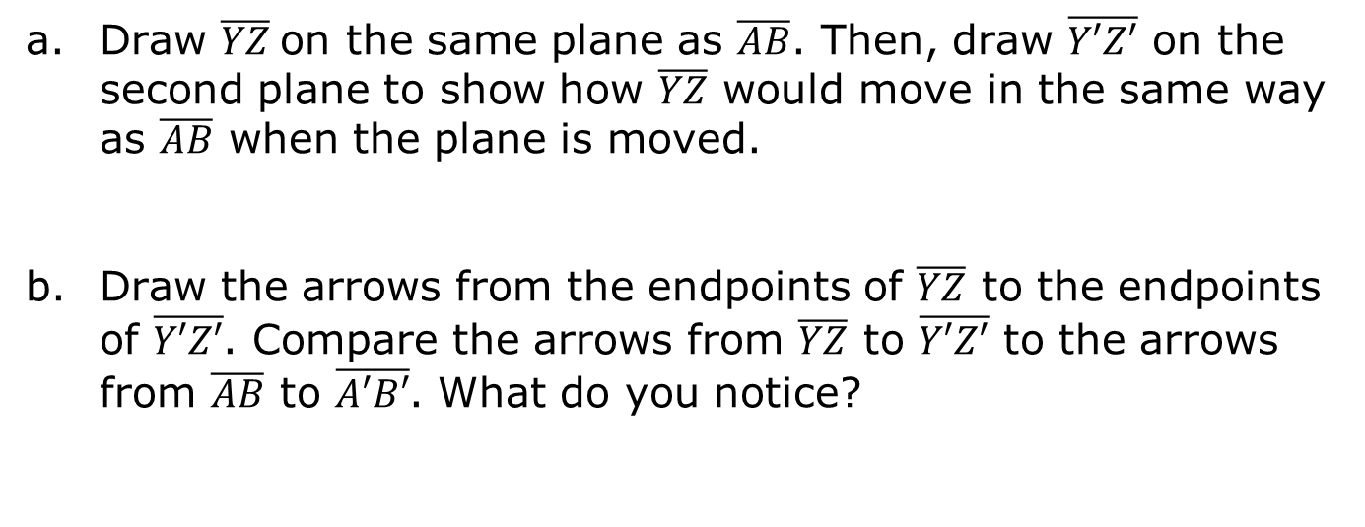
Draw $\overline{YZ}$on the same plane as $\overline{AB}$. Then, draw $\overline{Y′Z′}$ on the second plane to show how $\overline{YZ}$ would move in the same way as $\overline{AB}$ when the plane is moved.
Draw the arrows from the endpoints of $\overline{YZ}$ to the endpoints of $\overline{Y′Z′}$. Compare the arrows from $\overline{YZ}$ to $\overline{Y′Z′}$ to the arrows from $\overline{AB}$ to $\overline{A′B′}$. What do you notice?
Isometry is a transformation that preserves distance and angle measure
Use the definition of isometry to justify that Traci’s example is an isometry.
volume 1, pg. 207/208

Slide 10
Exploration
volume 1, pg. 208

Slide 11
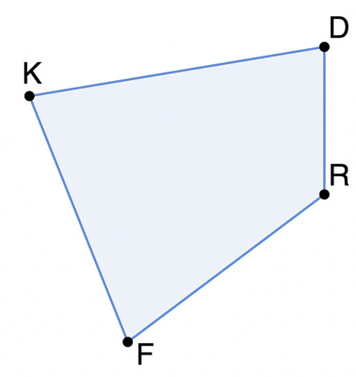
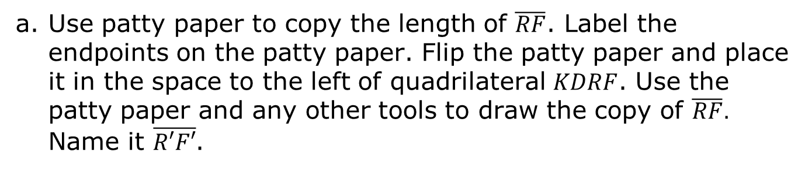
4.6.3 Exploration: Transformations and Isometry
Quadrilateral $KDRF$ is shown.
Use patty paper to copy the length of $\overline{RF}$. Label the endpoints on the patty paper. Flip the patty paper and place it in the space to the left of quadrilateral $KDRF$. Use the patty paper and any other tools to draw the copy of $\overline{RF}.$ Name it $\overline{R′F′}$.
A transformation is a one-to-one correspondence between two sets of points.
volume 1, pg. 208

Slide 12
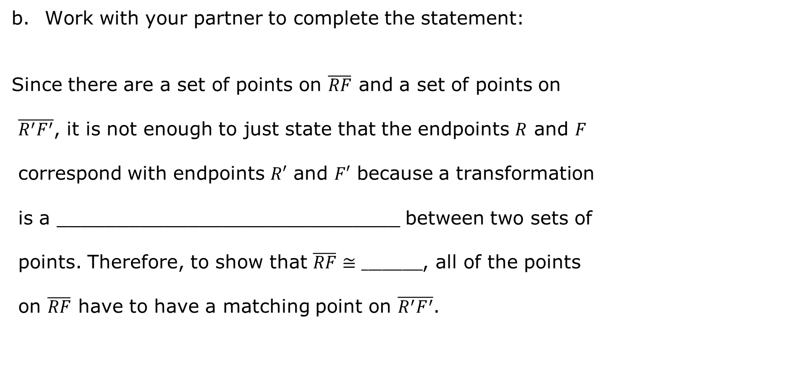
Work with your partner to complete the statement:
Since there are a set of points on $\overline{RF}$ and a set of points on
$\overline{R^{′}F^{′}}$, it is not enough to just state that the endpoints $R$ and $F$
correspond with endpoints $R′$ and $F′$ because a transformation
is a _____________________________ between two sets of
points. Therefore, to show that $\overline{RF}≅_________$, all of the points
on $\overline{RF}$ have to have a matching point on $\overline{R^{′}F^{′}}$.
volume 1, pg. 208

Slide 13
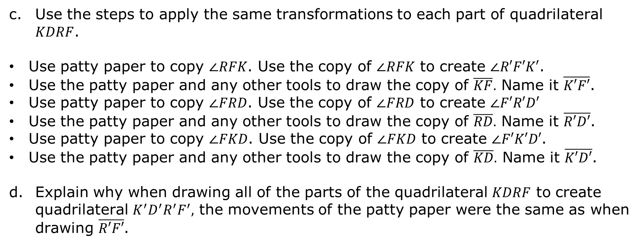
Use the steps to apply the same transformations to each part of quadrilateral $KDRF$.
Use patty paper to copy $∠RFK$. Use the copy of $∠RFK$ to create $∠R′F′K′$.
Use the patty paper and any other tools to draw the copy of $\overline{KF}.$ Name it $\overline{K′F′}$.
Use patty paper to copy $∠FRD$. Use the copy of $∠FRD$ to create $∠F′R′D′$
Use the patty paper and any other tools to draw the copy of $\overline{RD}.$ Name it $\overline{R′D′}$.
Use patty paper to copy $∠FKD$. Use the copy of $∠FKD$ to create $∠F′K′D′$.
Use the patty paper and any other tools to draw the copy of $\overline{KD}.$ Name it $\overline{K′D′}$.
Explain why when drawing all of the parts of the quadrilateral $KDRF$ to create quadrilateral $K^{′}D^{′}R^{′}F^{′},$ the movements of the patty paper were the same as when drawing $\overline{R′F′}$.
volume 1, pg. 209

Slide 14
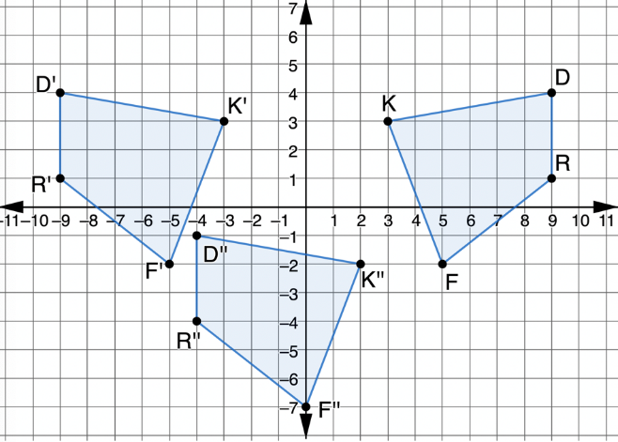
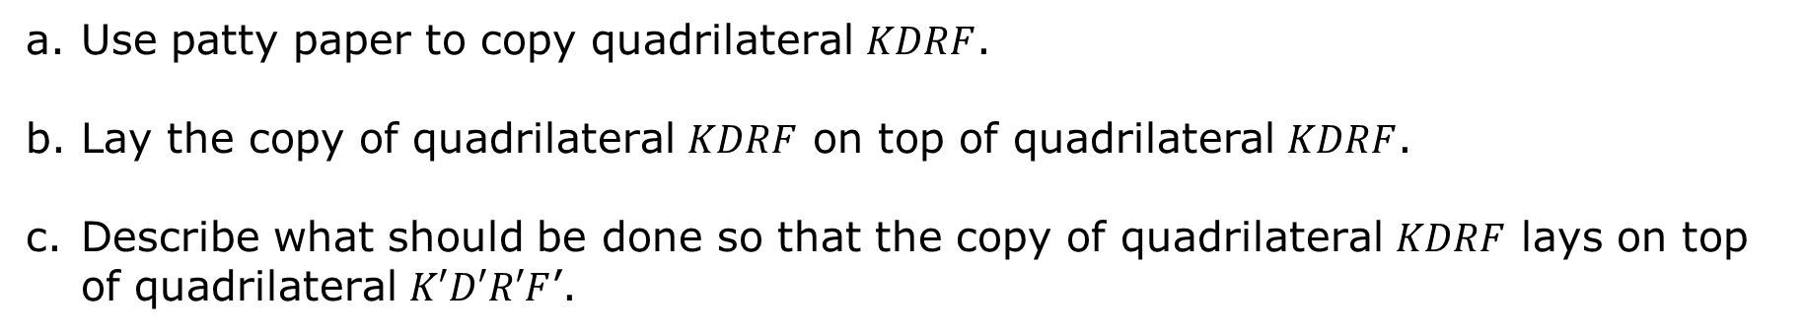
Quadrilaterals $KDRF$, $K′D′R′F′$, and $K′′D′′R′′F′′$ are shown on the coordinate grid.
Use patty paper to copy quadrilateral $KDRF$.
Lay the copy of quadrilateral $KDRF$ on top of quadrilateral $KDRF$.
Describe what should be done so that the copy of quadrilateral $KDRF$ lays on top of quadrilateral $K′D′R′F$’.
volume 1, pg. 209

Slide 15
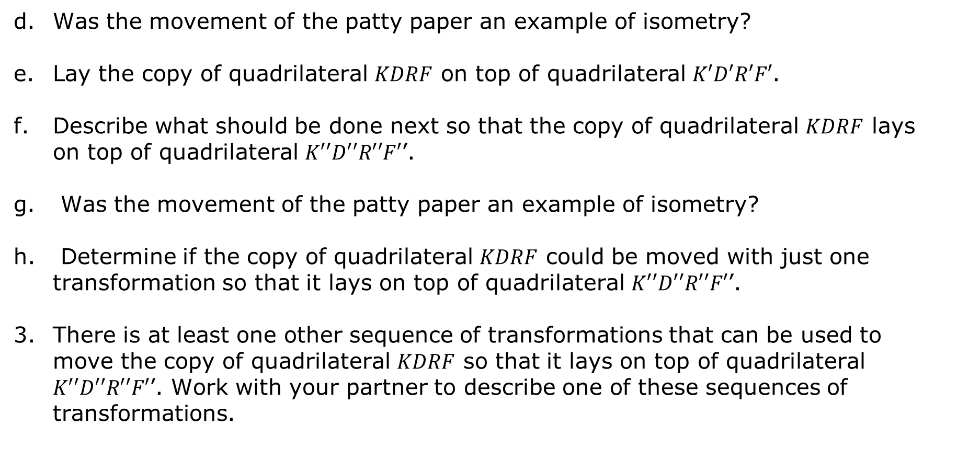
Was the movement of the patty paper an example of isometry?
Lay the copy of quadrilateral $KDRF$ on top of quadrilateral $K′D′R′F′$.
Describe what should be done next so that the copy of quadrilateral $KDRF$ lays on top of quadrilateral $K′′D′′R′′F′$’.
Was the movement of the patty paper an example of isometry?
Determine if the copy of quadrilateral $KDRF$ could be moved with just one transformation so that it lays on top of quadrilateral $K′′D′′R′′F′$’.
There is at least one other sequence of transformations that can be used to move the copy of quadrilateral $KDRF$ so that it lays on top of quadrilateral $K′′D′′R′′F′$’. Work with your partner to describe one of these sequences of transformations.
volume 1, pg. 209/210

Slide 16
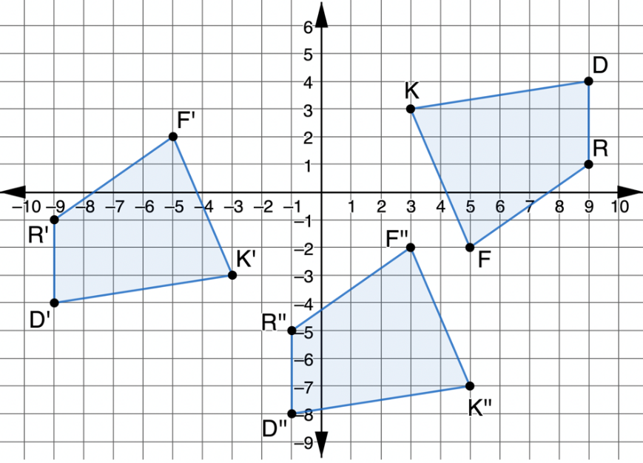

The coordinate grid shows a different sequence of transformations of quadrilateral $KDRF$.
Describe what movements should be done with your patty paper copy of quadrilateral $KDRF$ so that the copy of quadrilateral $KDRF$ lays on top of quadrilateral $K′′D′′R′′F′$’, by first laying on top of quadrilateral$K′D′R′F′$.
volume 1, pg. 210

Slide 17

Bring It Together
volume 1, pg. 211

Slide 18

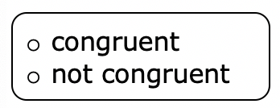
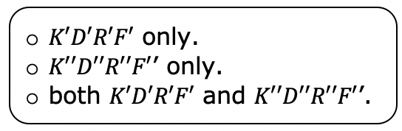
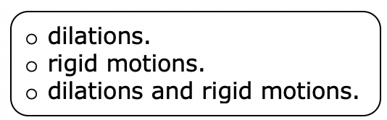
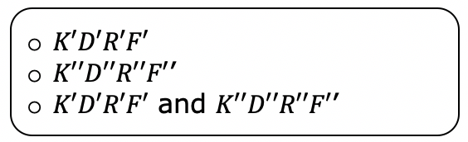
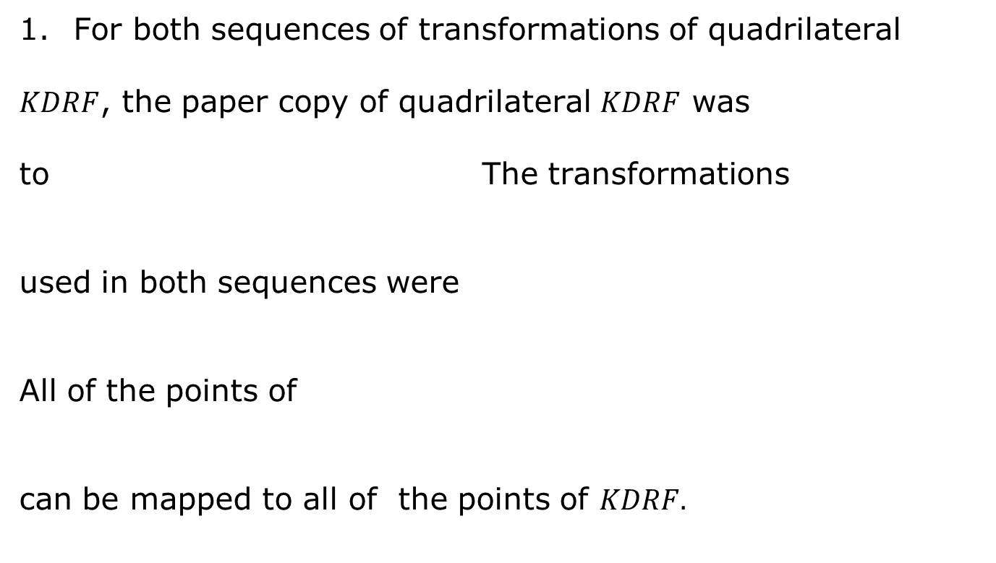
4.6.4 Bring It Together: Definition of Congruence in Terms of Rigid Motions
For both sequences of transformations of quadrilateral
$KDRF$, the paper copy of quadrilateral $KDRF$ was
to The transformations
used in both sequences were
All of the points of
can be mapped to all of the points of $KDRF.$
volume 1, pg. 211

Slide 19


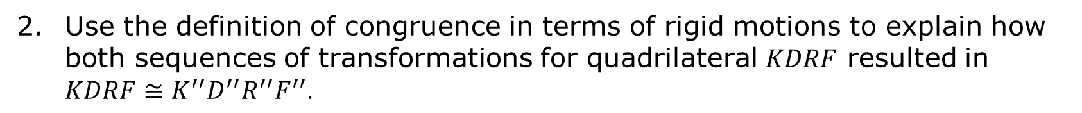
Definition of Congruence in Terms of Rigid Motions
Two figures are congruent if and only if there exists one or more rigid motions, which will map one figure onto the other.
Use the definition of congruence in terms of rigid motions to explain how both sequences of transformations for quadrilateral $KDRF$ resulted in $KDRF≅K^{′′}D^{′′}R^{′′}F^{′′}.$
volume 1, pg. 211

Slide 20

Wrap-Up
volume 1, pg. 212

Slide 21
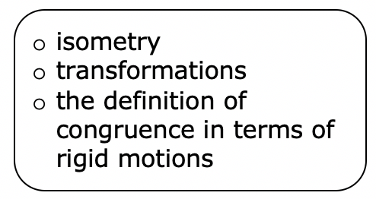
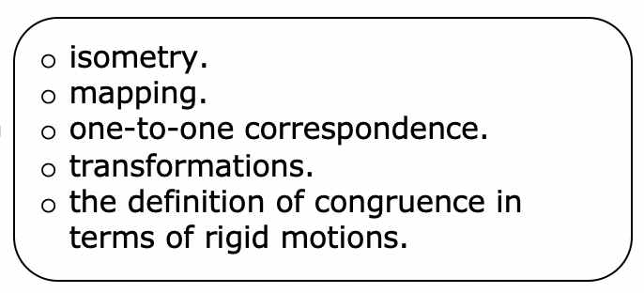
4.6.5 Wrap-Up: Growth Mindset
The power of “YET.”
“The power of believing that you can improve.” - Carol Dweck
Select all of the concepts that apply to your understanding right now.
I don’t understand YET.
doesn’t make sense to me YET.
volume 1, pg. 212

Slide 22
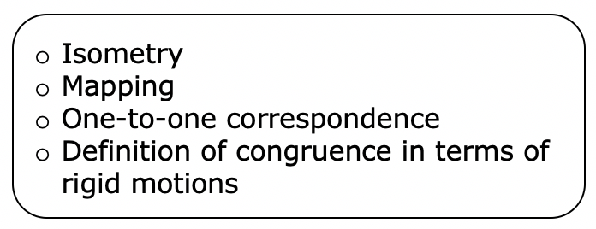
I can explain
volume 1, pg. 212

